Slide 1

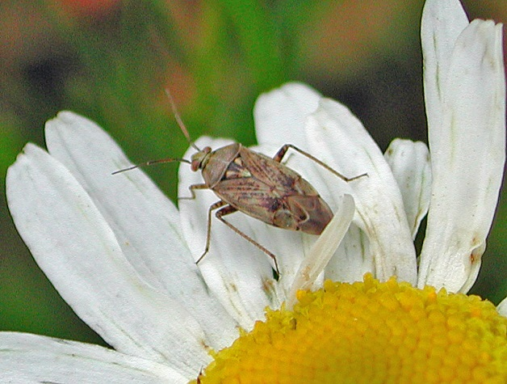
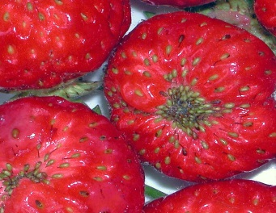
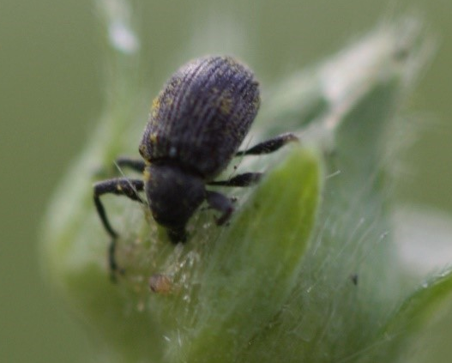
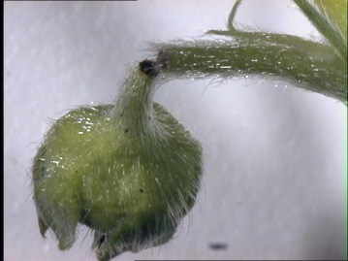
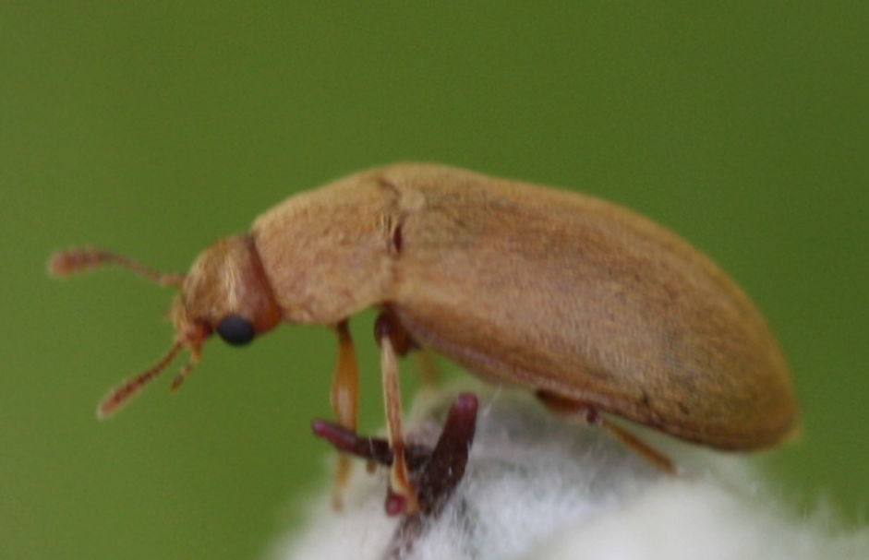
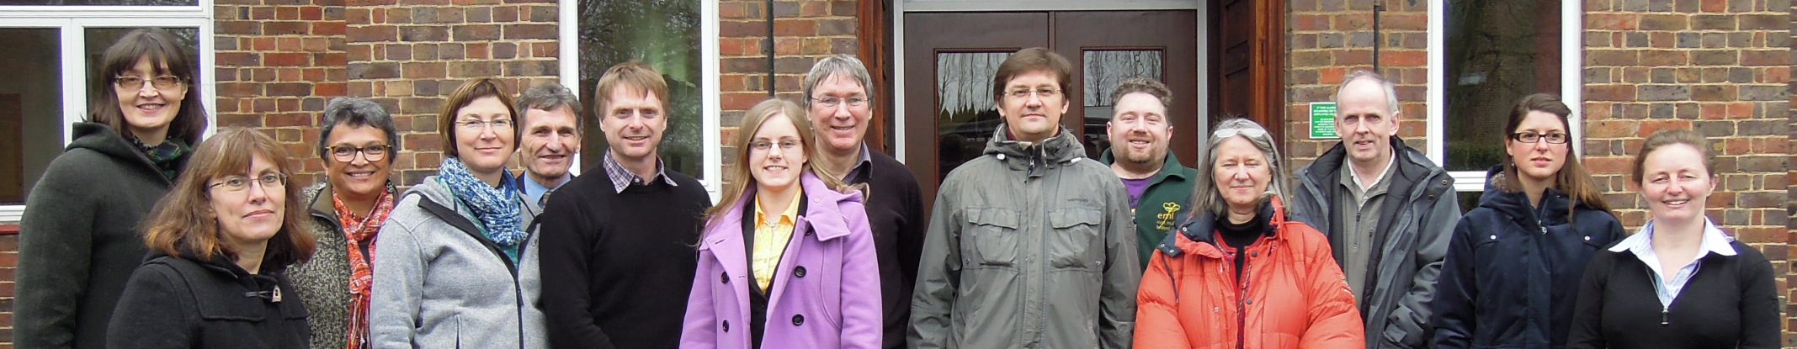







Softpest Multitrap
Background:
Cause large losses in yield
(10 - >80%) and quality of organically grown strawberry and raspberry
European tarnished plant bug
(Lygus ruulipennis)
Objective: By exploiting natural semiochemical mechanisms of sexual and host plant attraction, to develop effective traps for these insect species or repealing them from the field
Strawberry blossom weevil
(Anthonomus rubi)
Raspberry beetle
(Byturus tomentosus)

Slide 2
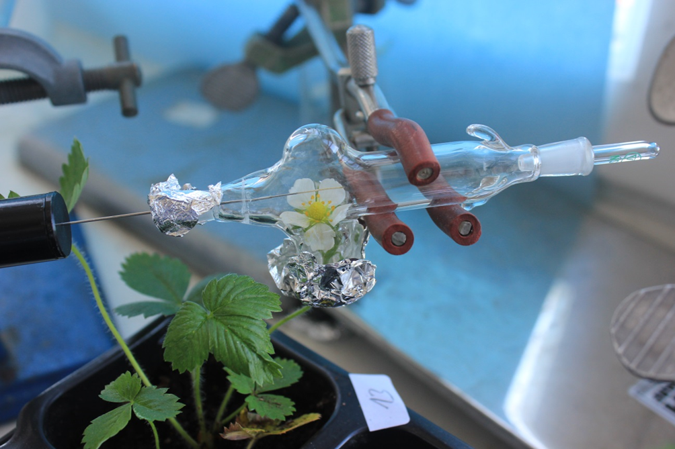
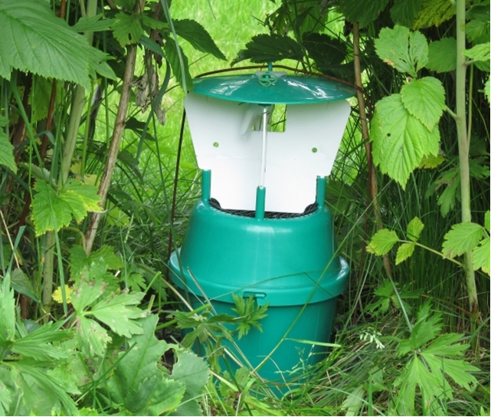
Softpest Multitrap
Some results:
WP 1 - Chemical analysis of plant volatiles
The same sesquiterpenes identified in both strawberry and
raspberry; potential insect pheromone synergists.
Possible insect repelling volatiles identified.
WP 2 - Pest insects in strawberry
A. rubi: weevils caught throughout the growing season.
L. rugulipennis: later peak catches in Denmark and UK.
than in Norway; more generations per year in the south.
For both higher catches in the crop than in the boundary vegetation.
WP 3 - Pest insects in raspberry
A. rubi: CH: peak new gen. > peak overwintering gen.
  NOR: peak overwintering gen. > peak new gen.
B. tomentosus: Highest catch rates between leaves development and single flower buds
Fewer damaged flowers in plots with traps than control plot.
Trap density: more severe flower damage in plots with a high compared to a low density.
WP 4 - Trap design
Traps with green cross vanes the most effective for trapping both A. rubi and L. rugulipennis.
  A. rubi: attracted to the traps but catch rates appears relatively low.
  L. rugulipennis: observed to walk on the cross vanes without falling down.

Slide 3
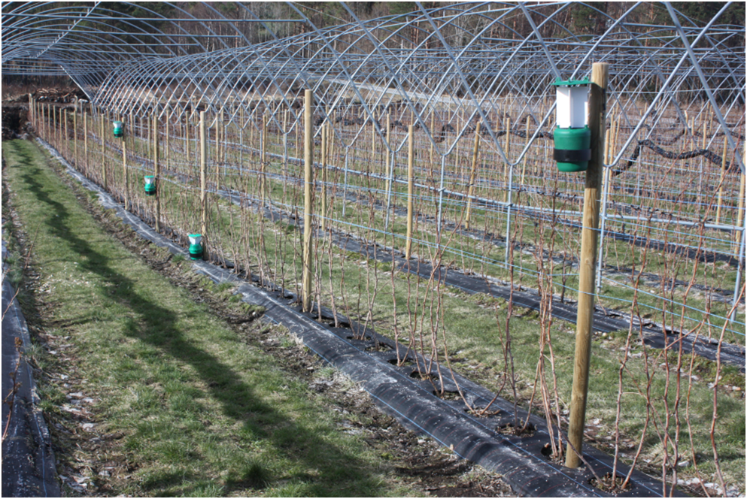
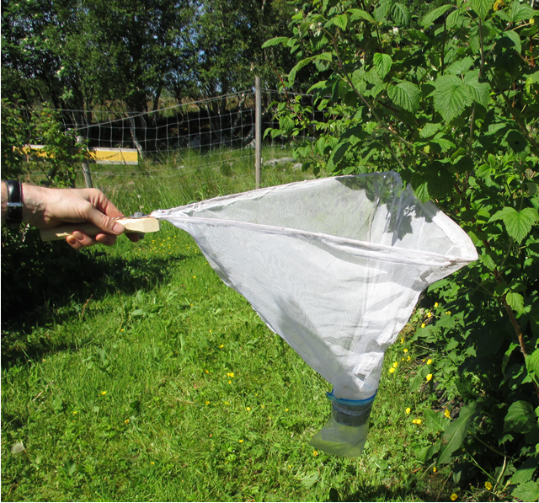
Softpest Multitrap
Recommendations to soft berry producers:
Pest insects in strawberry
• Mount traps on the ground in the crop.
• Use the green cross vane trap without the bee excluder grid to catch both species.
• In perennial strawberry crops, traps should stay in the field till end of September to reduce overwinter generation
Pest insects in raspberry
• For A. rubi mount traps on the ground
• Mount traps in the crop before spring emergence
• To catch B. tomentosus: use traps with lures containing raspberry volatile and the beetle aggregation pheromone.
• Change volatile lures on the traps before the new generation of A. rubi appear in the crop.

